Slide 1
Top1000 Youtube Channels Analysis to Marketing Campaign

Slide 2
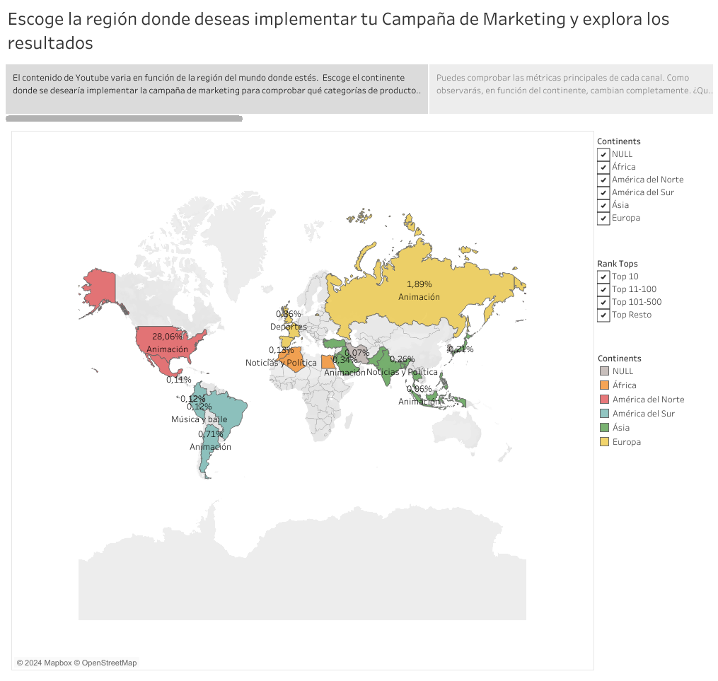

Slide 3
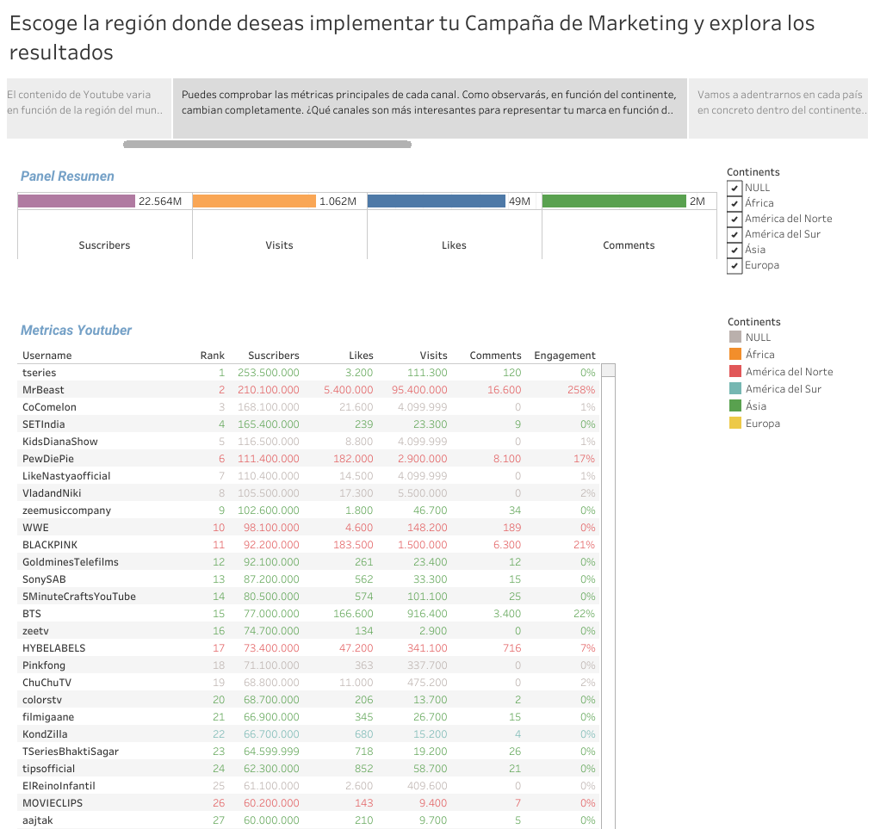

Slide 4
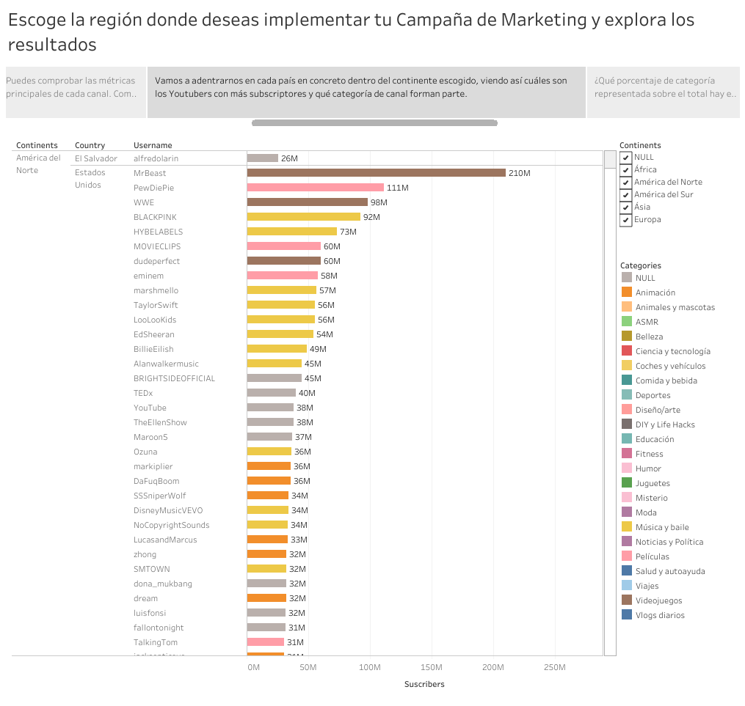

Slide 5
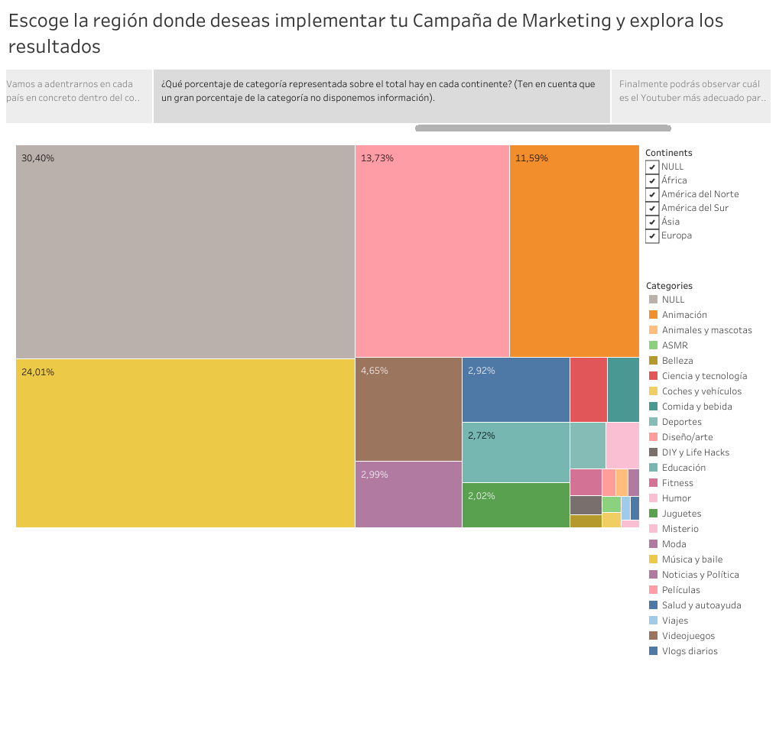

Slide 6
